Slide 1

Lecture 5: Properties of DNA data and assessing robustness of hypotheses
IBIO, Molecular Phylogenetics 2024
Jadranka Rota and Niklas Wahlberg
Systematic Biology Group
Department of Biology
Lund University

Slide 2
Data: how much is needed?
more sequence or more individuals, tens of genes or thousands of gene?

Slide 3
How much data?
All extant species?
The whole genome?
Impractical?
Trade-off between more genes and more taxa
Think about your study/question
How deep in time does your phylogeny go?
Deeper phylogenies require more sequence data
What are you going to do with the phylogeny?
Change classification, infer historical biogeography, study character evolution, …?

Slide 4
Choosing taxa or data
Know your group – which taxa are the most relevant for your study?
Include representative of all major clades
Iterative process: lab work for a set of taxa, preliminary analyses can inform further sampling
Know what gene sequences are available from previous studies
Databases: GenBank, BOLD (DNA barcodes)
So you’re not duplicating efforts

Slide 5
Number of genes
Single gene datasets – not very good for resolving phylogenies
Very rare nowadays
Mitochondrial and chloroplast DNA used to be very popular because easy to amplify and sequence
But they have some inherent problems
Nuclear genes – worth increasing their number
Can evolve independently from each other
When different nuclear genes give the same phylogeny, our confidence in the hypothesis grows

Slide 6
Number of taxa
What is good taxon sampling? – 10%, 20%, 50% of extant taxa?
The more, the better (usually)
Again, it depends on your question
Important to sample across your group of interest, not to leave out entire lineages
Level of taxon sampling – different across different groups in the literature
Dense taxon sampling in well known groups – vertebrates, plants, some insect groups (e.g. butterflies)
Relatively low taxon sampling – many invertebrate groups

Slide 7
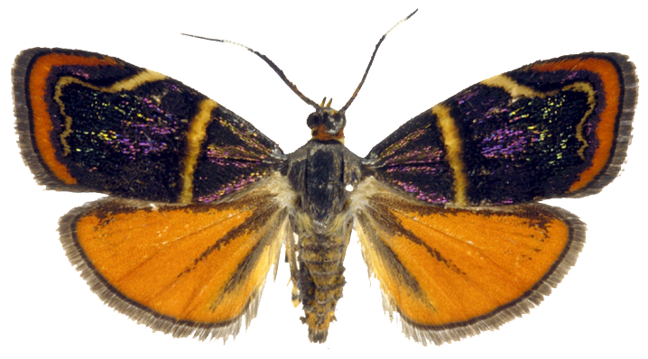
Adding genes and adding taxa helps!
Saptha
Choreutis
3 genes, 42 taxa (Rota 2011)
8 genes, 38 taxa (Rota & Wahlberg 2012)
11 genes, 146 taxa (Rota unpubl.)
An empirical example: metalmark moths (Lepidoptera, Choreutidae), ca. 600 known species
Analysis: MrBayes; Branch support: Bayesian posterior probability

Slide 8
Missing data?
Sometimes not all genes amplify/are found from all samples
Should these samples be discarded?
No – increased taxon sampling, despite missing data, usually increases resolution
As long as missing data are spread out across the phylogeny
Start with using all available data in your data exploration
And perhaps drop some taxa if they are behaving as ’rogues’
’rogue taxa’ – taxa that jump around in the phylogeny

Slide 9
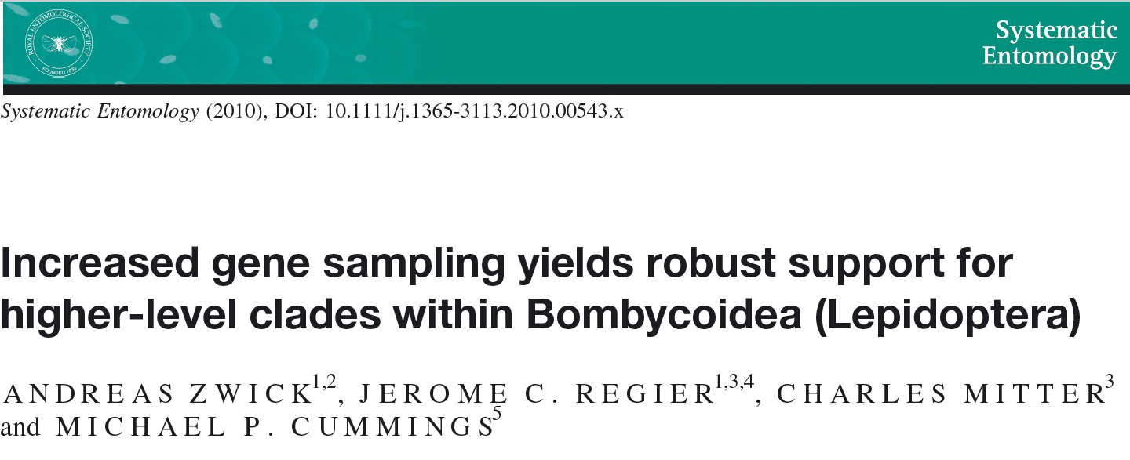
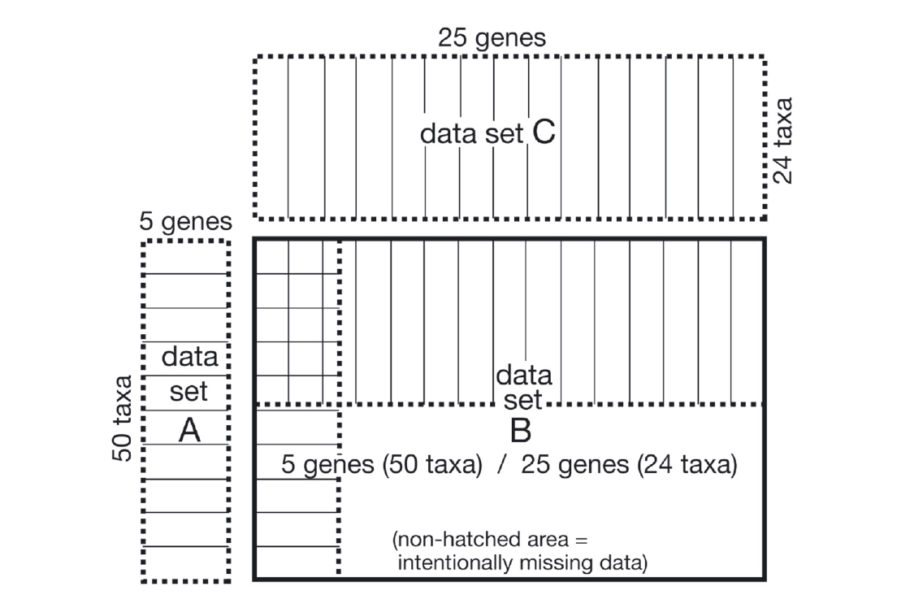

Slide 10
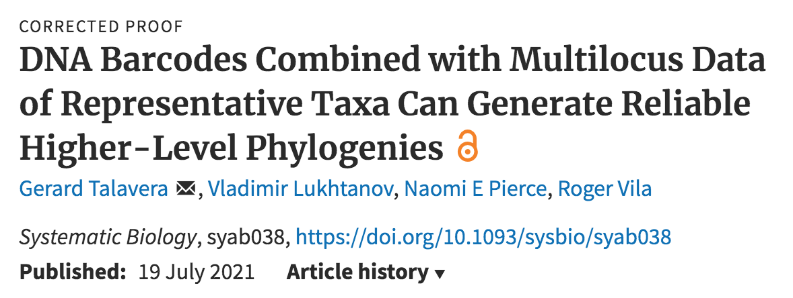
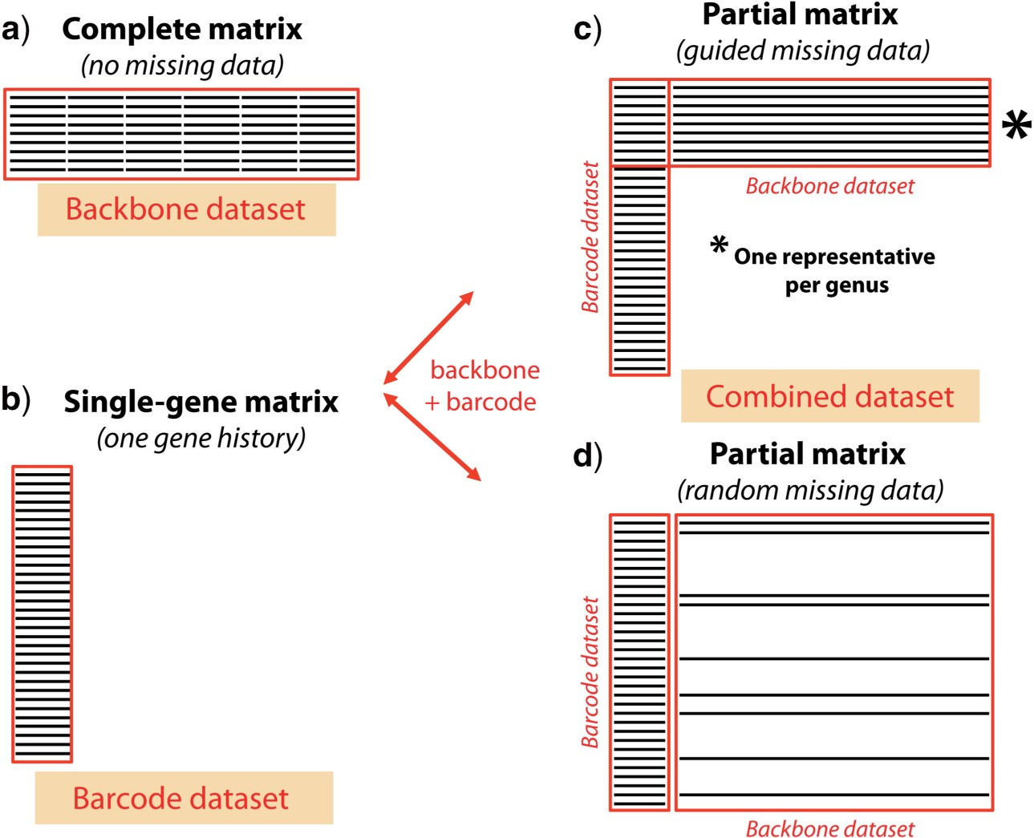

Figure 1. Distribution of missing data in molecular matrices. a) A complete matrix, where no missing data are involved (referred as the backbone data set). b) A single-gene matrix, including only one molecular marker and therefore providing information about only one gene history (referred as the barcode data set). c) The combined matrix, the product of merging a backbone and a barcode data set…
Notes:
Figure 1. Distribution of missing data in molecular matrices. a) A complete matrix, where no missing data are involved (referred as the backbone data set). b) A single-gene matrix, including only one molecular marker and therefore providing information about only one gene history (referred as the barcode data set). c) The combined matrix, the product of merging a backbone and a barcode data set, where one marker (DNA-barcode) is present for all specimens, but other markers are entirely sampled only for a reduced percentage of specimens that have been selected by prioritizing representatives of higher-level taxonomic categories. d) A combined matrix, where the selection of fully sequenced specimens, and therefore the distribution of missing data, is randomly sampled (usually as a result of merging data sets from various sources).
Unless provided in the caption above, the following copyright applies to the content of this slide: © The Author(s) 2021. Published by Oxford University Press on behalf of the Society of Systematic Biologists.This is an Open Access article distributed under the terms of the Creative Commons Attribution License ( (http://creativecommons.org/licenses/by-nc/4.0/), which permits unrestricted reuse, distribution, and reproduction in any medium, provided the original work is properly cited.

Slide 11
Phylogenomics
Number of genes sequenced is in hundreds or thousands
Whole genome analyses allow us to understand:
Intron-exon boundary dynamics
Gene duplication-deletion dynamics
Gene transfer dynamics
We are getting a good understanding of the regions of the genome that are most suitable for systematics
Single copy, protein-coding nuclear genes seem to work well

Slide 12
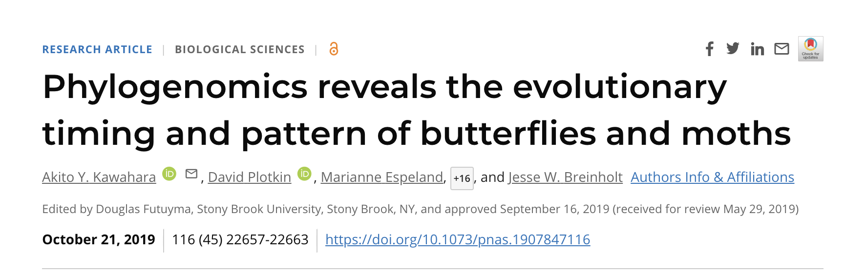
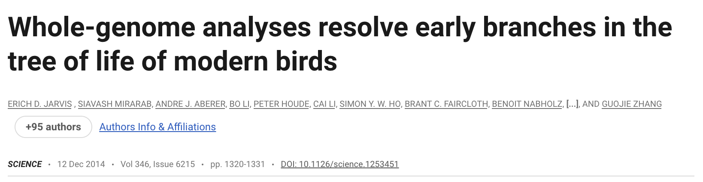
Is having thousands of genes enough to resolve phylogenies?

Slide 13
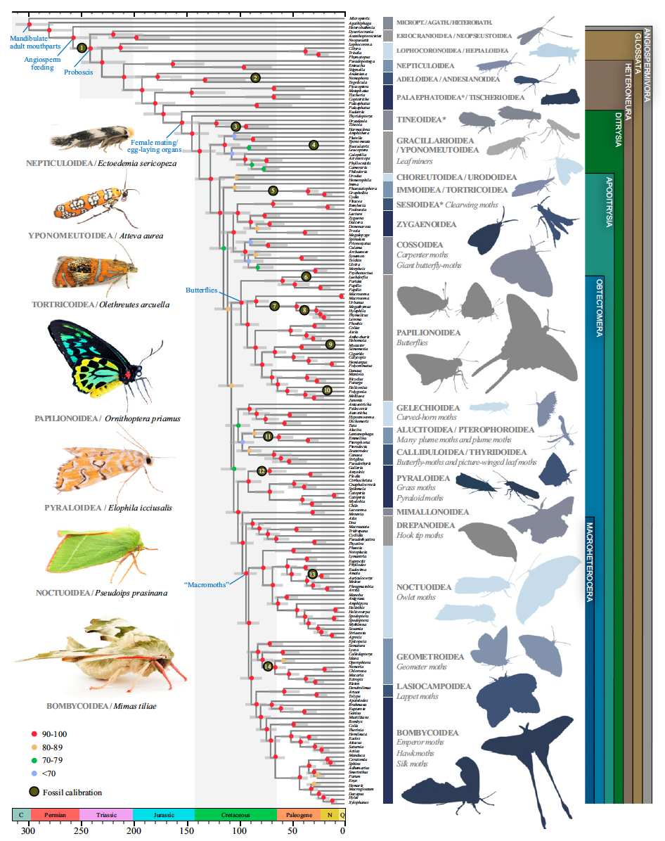
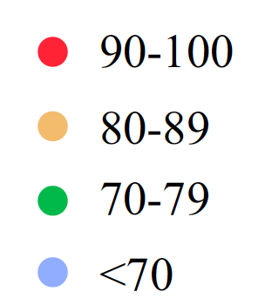
Kawahara et al. 2019 PNAS
Phylogeny of Lepidoptera
Bootstrap support – in red significant support
Fig. 1. Dated evolutionary tree of butterfly and moth relationships. The tree is derived from a maximum-likelihood analysis of 2098 genes (amino acid alignment).

Slide 14
Kawahara et al. 2019 PNAS
Phylogeny of Lepidoptera
Bootstrap support – in red significant support
Fig. 1. Dated evolutionary tree of butterfly and moth relationships. The tree is derived from a maximum-likelihood analysis of 2098 genes (amino acid alignment).

Slide 15
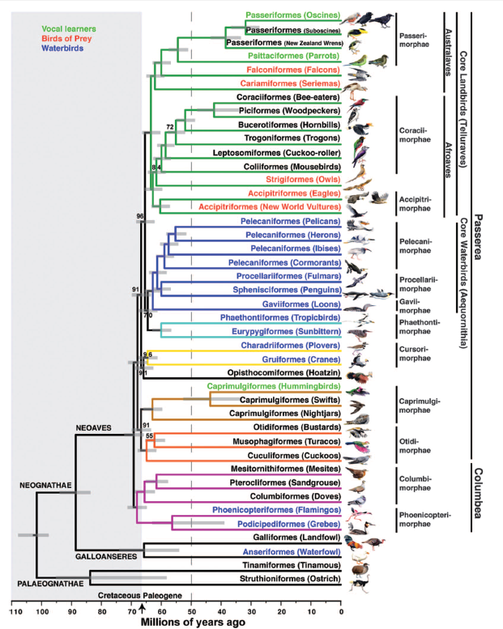
8251 genes
2516 introns
3769 ultraconserved elements
41.8 million bp…
Jarvis et al. 2014: Science 346

Slide 16
Properties of DNA data important to consider
Saturation and long-branch attraction
Incomplete lineage sorting
Lateral gene transfer
Mito-nuclear discordance
Biased base composition

Slide 17
Multiple changes at a single site – hidden changes
Ancest GGCGCG
Seq 1 AGCGAG
Seq 2 GCGGAC
Number of changes
1
2
3
Seq 1
C
G
T
A
Seq 2
C
A
1

Slide 18
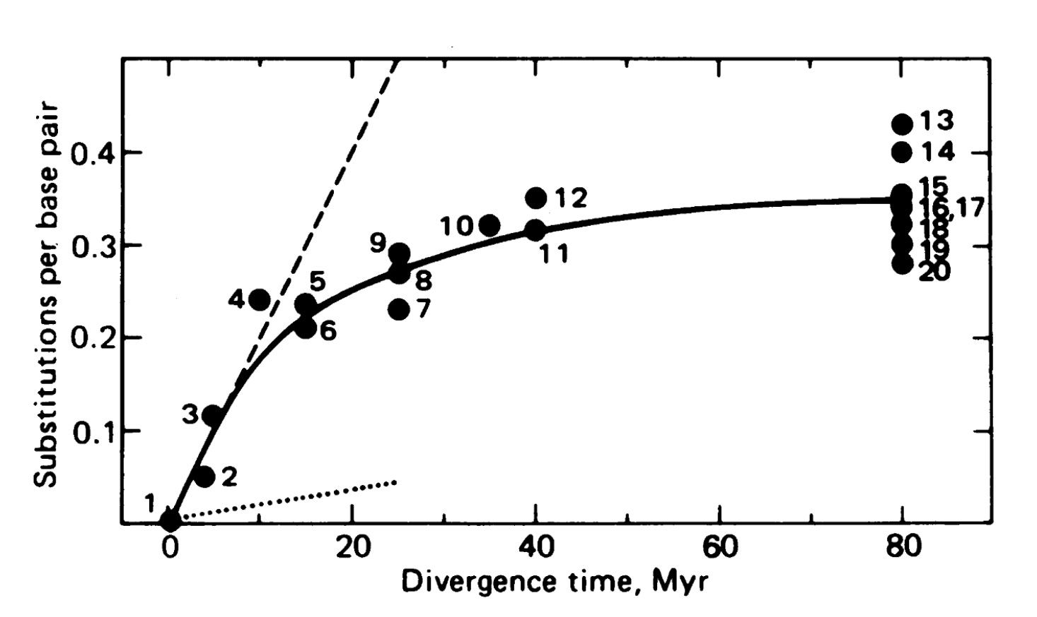
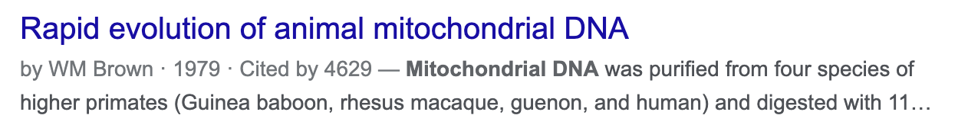
“Multiple hits” or saturation
Brown et al. 1979. PNAS 76:1967

Slide 19
Saturation and long-branch attraction
Homoplasy (incorrectly inferred homology)
One of the issues with molecular data
Made worse by having only four characters (A, C, G, T)
Long-branch attraction (LBA)
Elevated rates of molecular evolution in unrelated lineages
Sparse taxon sampling leading to long branches

Slide 20
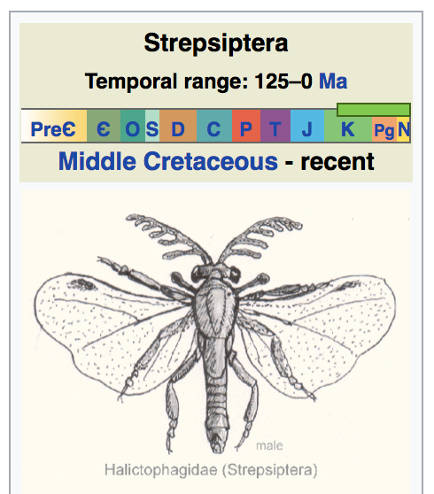
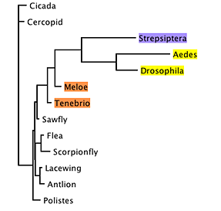
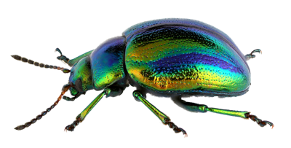
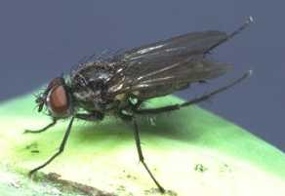
Classical LBA example
Flies (Diptera)
Beetles (Coleoptera)
Wikipedia
Based on 18S, 28S, and morphology
(Whiting & Wheeler 1994)
In 2012, question finally resolved with data from 13 insect genomes (18 mill. nucleotides)
Photo by C. Fägerström

Slide 21
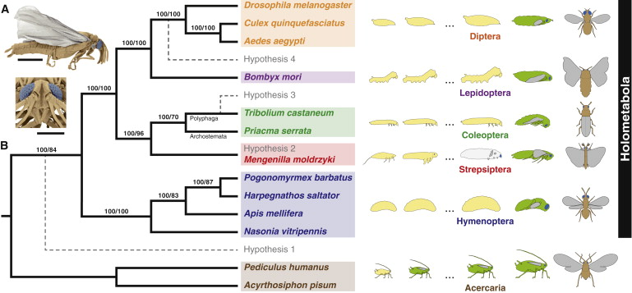
Strepsiptera are sister to beetles
Figure 1. Evolutionary Origin of Twisted-Wing Parasites Inferred from Genomic Evidence(A) Mengenilla moldrzyki male in lateral (top; scale bar represents 1 mm) and frontal (bottom; scale bar represents 500 μm) view (colored SEM micrographs; wings in gray, comp...
Oliver Niehuis, Gerrit Hartig, Sonja Grath, Hans Pohl, Jörg Lehmann, Hakim Tafer, Alexander Donath, Veiko Krauss, Carina Eisenhardt, Jana Hertel, Malte Petersen, Christoph Mayer, Karen Meusemann, Ralph S. Peters...
Genomic and Morphological Evidence Converge to Resolve the Enigma of Strepsiptera
Current Biology, Volume 22, Issue 14, 2012, 1309–1313

Slide 22
What can we do about saturation/LBA?
Modelling DNA evolution
Taxon sampling is important – whenever possible break up long branches
For divergent taxa with few extant species, this can be a big problem
BUT branch support is usually low for long branches sticking together in model-based methods – so we should be able to recognize it!
”sticky” long branches – a bigger problem in parsimony
More data from different sources
Could be that molecular data are not able to resolve the position of some taxa
Morphological data!

Slide 23
Orthology or paralogy?
Are the genome regions sequenced from different species the same (homologous)?
Gene duplication
1) duplicate gene degenerates – pseudogene
2) duplicate gene aquires new function
A problem particularly accute currently as we analyze phylogenomic data

Slide 24
Orthology: gene trees and species trees
Gene phylogeny
Organism phylogeny
a
A
b
B
c
C
ORTHOLOGY
Orthologs: genes that arose due to speciation

Slide 25
Paralogy: can produce misleading trees
Gene phylogenies
Organism phylogeny
a1
A
b1
B
Gene copy 1
c1
C
a2
b2
Gene copy 2
c2
gene duplication
PARALOGY
Paralogs: genes that arose due to duplication events

Slide 26
Paralogy: can produce misleading trees
Gene phylogenies
Organism phylogeny
a1*
A
b1
B
Gene copy 1
c1*
C
Misleading tree
a2
a1
A
b2*
Gene copy 2
c1
C
c2
gene duplication
PARALOGY
b2
B
Paralogs: genes that arose due to duplication events

Slide 27
Incomplete lineage sorting (ILS)
Gene trees may not be the same as species trees
Usually not a problem for deep phylogenies BUT…
Extant populations may retain ancestral polymorphisms
Species level phylogenies should never sample single individuals of different species
Sample several individuals from across the range

Slide 28
Are species monophyletic?
Implicit assumption in many studies using mtDNA – DNA barcoding
Theoretical studies predict that DNA lineages pass through several phases in evolution of a species

Slide 29
The assumption: monophyly
A
B
Time
Ancestral haplotypes

Slide 30
The assumption: monophyly
A
B
Time

Slide 31
The presence of poly- and paraphyletic lineages
Paraphyly can occur when one population in a set of locally panmictic populations speciates
Polyphyly occurs when a highly polymorphic population is subdivided
Can be highly informative of the history of divergence
i.e., how speciation occurred

Slide 32
Paraphyly
A
B
Time
Ancestral haplotypes

Slide 33
Paraphyly
A
B
Time

Slide 34
Polyphyly
A
B
Time

Slide 35
Polyphyly
A
B
Time

Slide 36
Polyphyly

Slide 37
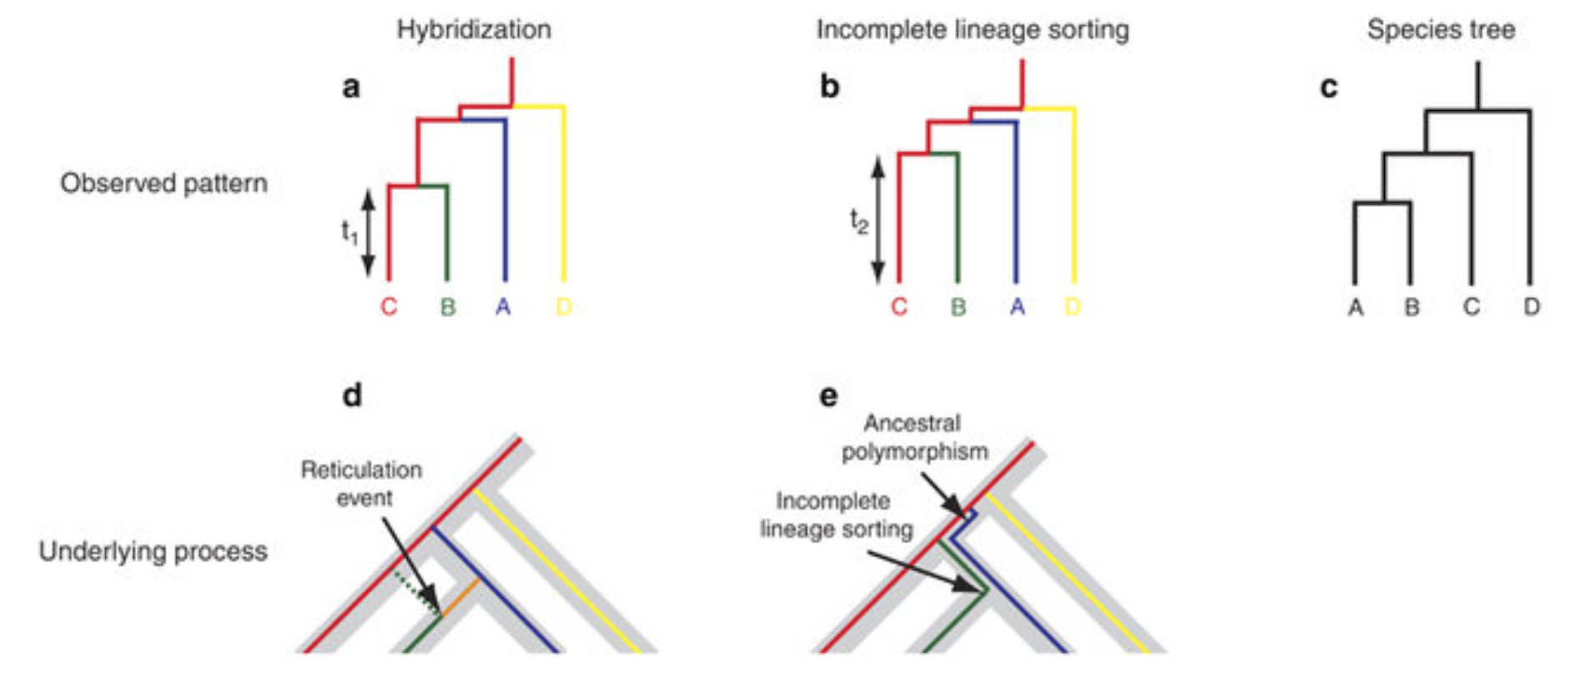
Paraphyly of a species can be due to incomplete lineage sorting and/or secondary gene flow
C B A D
C B A D
Figure from ResearchGate, uploaded by Richard A Ennos

Slide 38
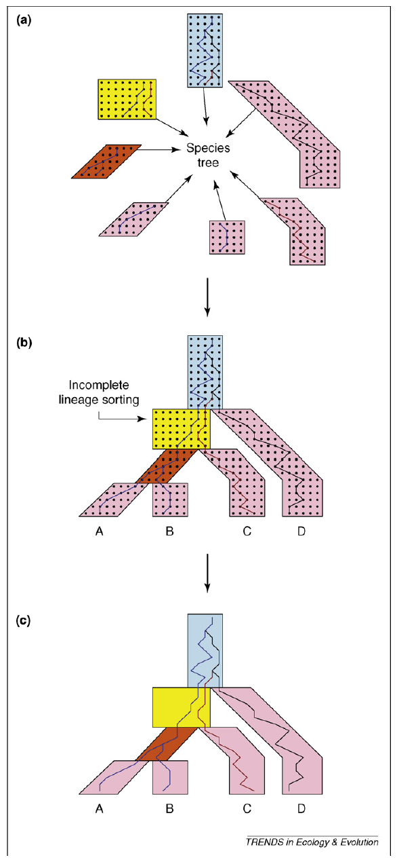
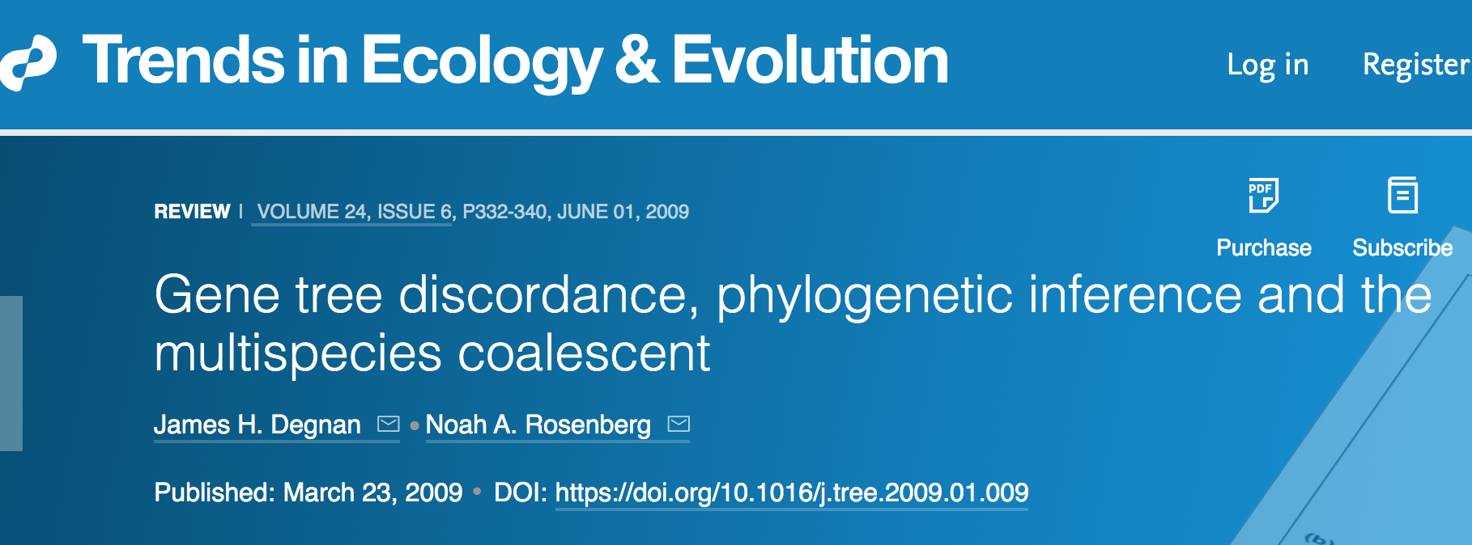
Multispecies coalescent model (MSC)
Gene tree vs. species tree
Model that accommodates gene tree heterogeneity caused by ILS
ASTER package (ASTRAL IV)

Slide 39
Lateral (=Horizontal) Gene Transfer
Widespread in single-celled organisms
Even between distantly related lineages
In multi-celled organisms more a problem in closely related species
It happens through hybridization
Some estimates suggest that 25% of plant species and 10% of animal species hybridize (Mallet 2005 TREE 20(5):229-237)

Slide 40
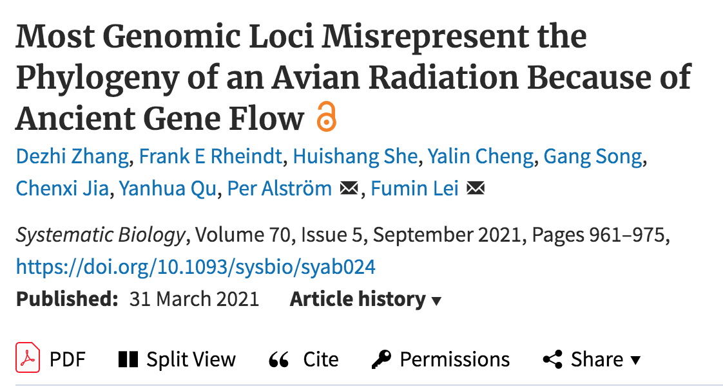
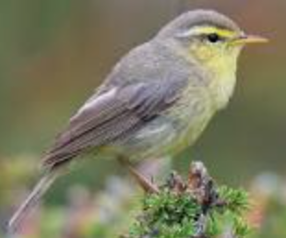
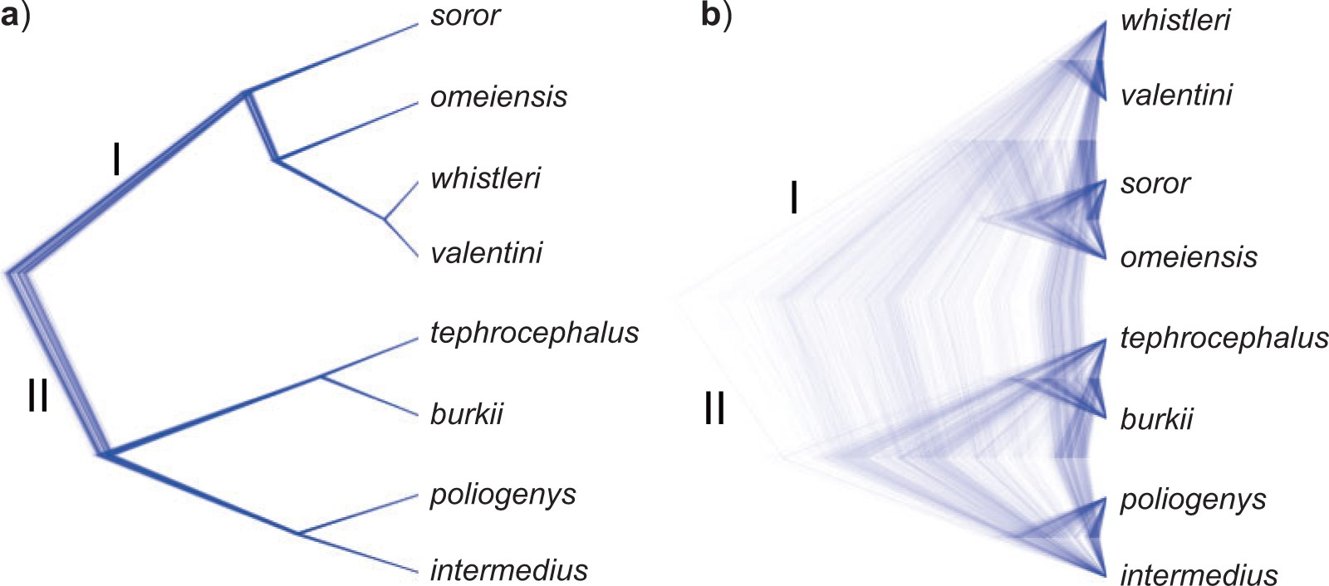
Figure 4. Species trees estimated using SNAPP (including five samples per species). a) Species tree based on [one subset of sequence data and b) species tree based on a different subset]… All nodes are supported by a posterior probability of 1.00.
Leaf warblers
Notes:
Figure 4. Species trees estimated using SNAPP (including five samples per species). a) Species tree based on a subset of SNVs (288,355 SNVs) from the IQTREE data set with a distance of $ \ge $1000 bp; b) species tree based on a subset of SNVs (1936 SNVs) from the RAxML data set with a distance of $ \ge $1000 bp. All nodes are supported by a posterior probability of 1.00.
Unless provided in the caption above, the following copyright applies to the content of this slide: © The Author(s) 2021. Published by Oxford University Press, on behalf of the Society of Systematic Biologists.This is an Open Access article distributed under the terms of the Creative Commons Attribution Non-Commercial License (http://creativecommons.org/licenses/by-nc/4.0/), which permits non-commercial re-use, distribution, and reproduction in any medium, provided the original work is properly cited. For commercialre-use, please contact journals.permissions@oup.com

Slide 41
Figure 4. Species trees estimated using SNAPP (including five samples per species). a) Species tree based on [one subset of sequence data and b) species tree based on a different subset]… All nodes are supported by a posterior probability of 1.00.
Leaf warblers
Notes:
Figure 4. Species trees estimated using SNAPP (including five samples per species). a) Species tree based on a subset of SNVs (288,355 SNVs) from the IQTREE data set with a distance of $ \ge $1000 bp; b) species tree based on a subset of SNVs (1936 SNVs) from the RAxML data set with a distance of $ \ge $1000 bp. All nodes are supported by a posterior probability of 1.00.
Unless provided in the caption above, the following copyright applies to the content of this slide: © The Author(s) 2021. Published by Oxford University Press, on behalf of the Society of Systematic Biologists.This is an Open Access article distributed under the terms of the Creative Commons Attribution Non-Commercial License (http://creativecommons.org/licenses/by-nc/4.0/), which permits non-commercial re-use, distribution, and reproduction in any medium, provided the original work is properly cited. For commercialre-use, please contact journals.permissions@oup.com

Slide 42
Mito-nuclear discordance
Topological differences between well resolved phylogenies from mitochondrial and nuclear genes
Relatively widespread
Biological reasons for it: incomplete lineage sorting and lateral gene transfer
Operational reasons for it:
faster substitution rate in animal mitochondrial DNA compared to the nuclear
Too little phylogenetic signal for deeper relationships

Slide 43
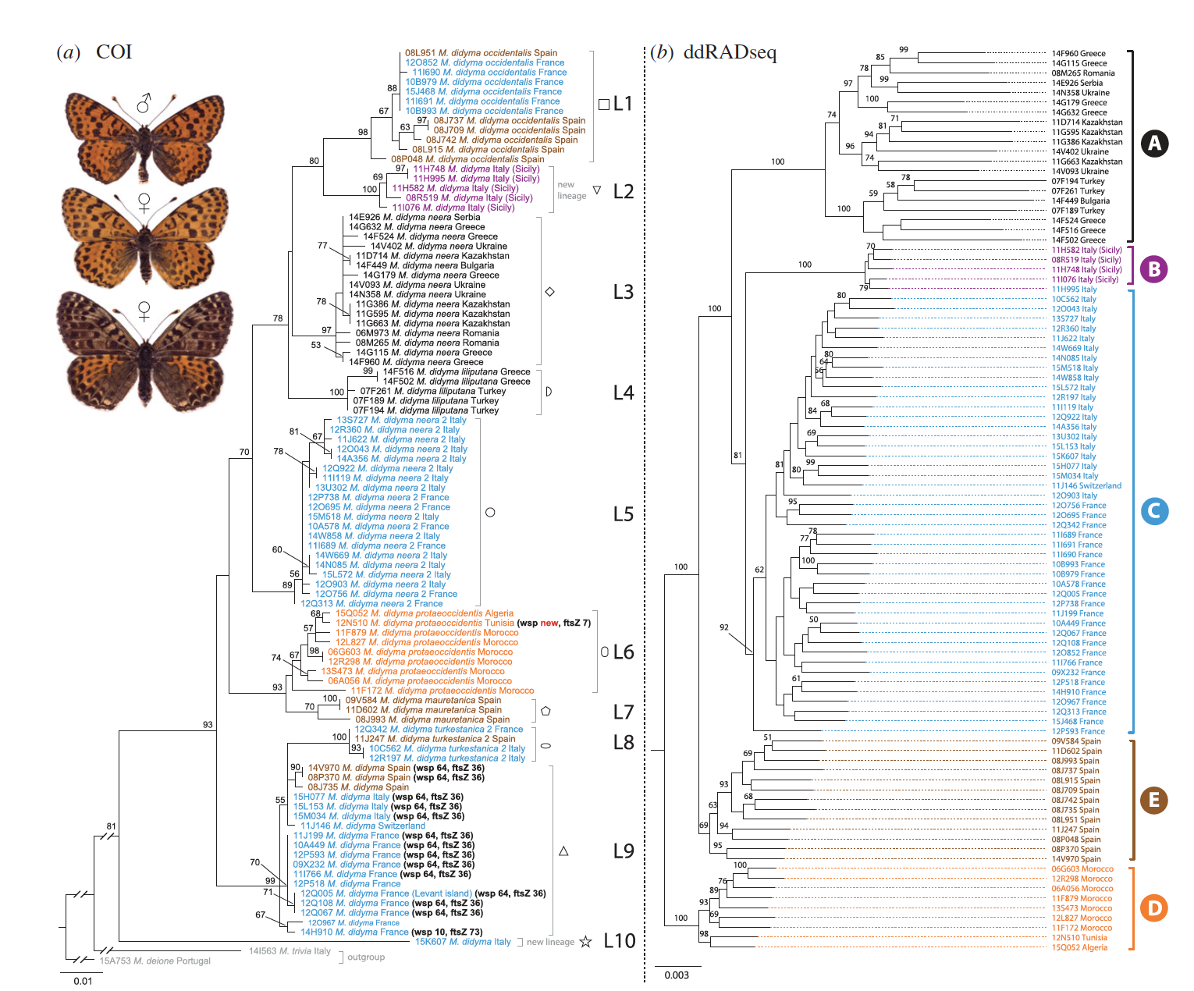
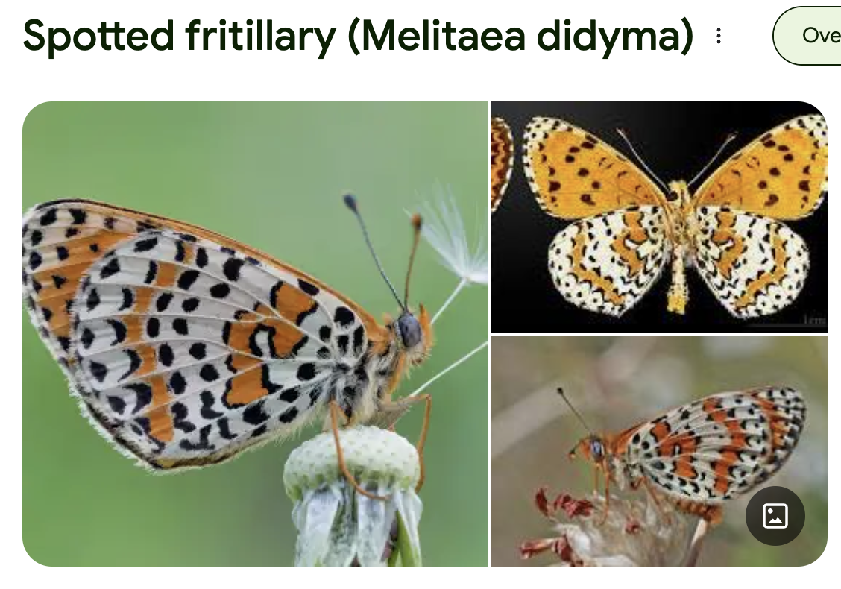

An empirical example: Melitaea butterflies
Dinca et al. (2019)
Proc. Roy. Soc B,
286: 20191311

Slide 44
An empirical example: Melitaea butterflies
Dinca et al. (2019)
Proc. Roy. Soc B,
286: 20191311

Slide 45
Biased base composition

Slide 46
Biased base compositions?
Do sequences manifest biased base compositions or biased codon usage patterns, which may obscure phylogenetic signal?
E.g. some taxa have a high/low GC content, if they are inferred to belong to the same clade – is this real or is it because of their base composition?

Slide 47
Compositional hetereogeneity
Lepidoptera, 200 taxa representing most superfamilies, 332 genes
Bowker’s symmetry test
Amino acid
Nucleotide 1st 2nd codon
No deviation
Deviation highly significant
Rota et al. 2022

Slide 48
Properties of molecular data?
These properties are highly interesting phenomena in themselves!
When taking the different factors into account, can be informative about evolutionary history
”When in doubt, get more data”
Brooks and McLennan 2002
And then think about how to analyse your data given these properties

Slide 49
How good is our phylogenetic hypothesis?
Support and stability

Slide 50
Assessing phylogenetic hypotheses and signal in phylogenetic data
Inferring a tree is not enough
We also need to know how much support there is for our phylogenetic hypothesis in the data
How much confidence can we place in the phylogenetic hypothesis?
Do the data strongly support the relationships?
If not, we may end up drawing wrong conclusions about how evolution proceeded

Slide 51
Support and stability
How strongly do the data support your phylogenetic hypothesis?
How stable is your phylogenetic hypothesis?
Is it likely to change with the addition of new data?
Do you get the same result with different analysis methods?

Slide 52
Assessing phylogenetic hypotheses - Support
Several methods provide some measure of the strength of support for tree nodes
Nodal or branch support
These methods include:
Character resampling methods – bootstrap and jackknife
Posterior probability in Bayesian analysis

Slide 53
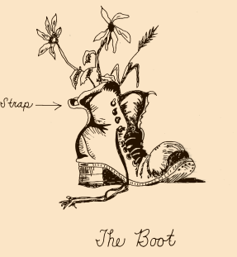
Bootstrapping
Statistical technique that uses random resampling of data to determine sampling error or confidence intervals for some estimated parameter
Introduced into phylogenetics by Felsenstein (1985)

Slide 54
Bootstrapping phylogenies
Characters are resampled with replacement to create many bootstrap pseudoreplicate data sets
Often 1000 pseudoreplicates done
Each bootstrap data set is analysed
Agreement among the resulting trees is summarized with a majority-rule consensus tree
Frequencies of occurrence of groups, bootstrap proportions (BPs), are a measure of support for those groups

Slide 55
Bootstrap
1
100
1
1 CGAGAC
2 AGCGAC
3 AGATTC
4 GGATAG
Original alignment
2
100
2
3
66
3
4
4
1 CGAGAA
2 AGAGAA
3 AGTTTT
4 GGATAA
1
2
Bootstrap values superimposed on majority-rule consensus tree
Pseudoreplicate 1
3
4
1 AGAGAC
2 AGCGCC
3 TGATAC
4 AGATAG
1
2
Pseudoreplicate 2
3
4
1 CCAGAC
2 ACCGAC
3 ACAGTC
4 GGAGAG
1
2
Bootstrapping doesn’t really assess the accuracy of a tree, it only indicates the consistency of the data
Pseudoreplicate n
(e.g. 1000)
3
4

Slide 56
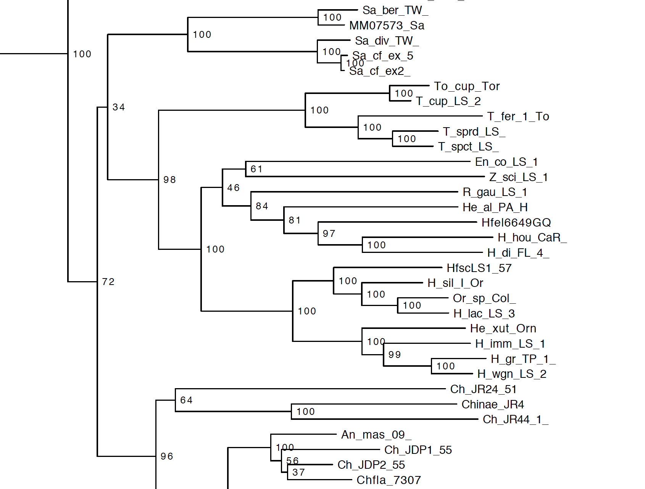
Bootstrapping – an example
Majority-rule consensus tree

Slide 57
Bootstrap - interpretation
Hillis & Bull 1993
Examined interpretation of BP using simulated data & known phylogenies
Conclusions:
Low BPs overestimate accuracy
High BPs underestimate accuracy - BP = 70% was statistically significant support (only applies to their simulated data)
Done on small datasets (few genes)
Phylogenomic datasets seem to inflate bootstraps – a higher number is needed to be considered significant

Slide 58
Other branch support measures
Ultrafast bootstrap (Nguyen et al. 2015)
10 to 40 times faster than RAxML rapid bootstrap and obtains less biased support values
Different interpretation from the usual bootstrap
These support values are more unbiased: 95% support correspond roughly to a probability of 95% that a clade is true
>=95% is significant
L.-T. Nguyen, H.A. Schmidt, A. von Haeseler, and B.Q. Minh (2015) IQ-TREE: A fast and effective stochastic algorithm for estimating maximum likelihood phylogenies. Mol. Biol. Evol., 32:268-274. DOI: 10.1093/molbev/msu300
D.T. Hoang, O. Chernomor, A. von Haeseler, B.Q. Minh, and L.S. Vinh (2018) UFBoot2: Improving the ultrafast bootstrap approximation. Mol. Biol. Evol., 35:518–522. DOI: 10.1093/molbev/msx281

Slide 59
Other branch support measures
SH-aLRT branch test
Shimodaira-Hasegawa approximate likelihood ratio test
>=80% is significant
Robust to various model assumption violations
Guindon et al. (2010) New Algorithms and Methods to Estimate Maximum-Likelihood Phylogenies: Assessing the Performance of PhyML 3.0. Syst. Biol. 59:307–321. DOI: 10.1093/sysbio/syq010
Anisimova et al. (2011) Survey of Branch Support Methods Demonstrates Accuracy, Power, and Robustness of Fast Likelihood-based Approximation Schemes. Syst. Biol. 60(5):685–699. DOI:10.1093/sysbio/syr041

Slide 60
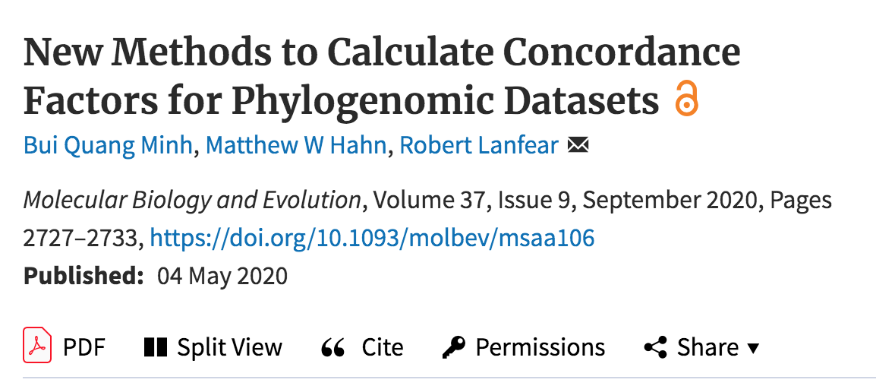
Concordance factors
gCF – gene concordance factor
Percentage of decisive gene trees containing that branch
Can be close to 0% if very few genes support a particular topology
sCF – site concordance factor
Percentage of decisive alignment sites supporting a branch in the reference tree
If alignment without phylogenetic signal, sCF ≈ 33%
Not necessarily high when bootstraps are high

Slide 61
Concordance factors example: UFB/gCF/sCF – potential issue: gene tree estimation error
Phylogeny of butterflies (332 genes, IQ-Tree)

Slide 62
ML vs. Bayesian view
ML maximizes probability of data, given the model/parameter values (incl. toplogy and branch lengths).
Confidence is measured by bootstrap
Bayesian inference – probability of topology with branch lengths and other parameters, given the data and the model
Confidence given by posterior probabilities
Ronquist & Deans 2010. Ann. Rev. Ent.

Slide 63
Bayesian Inference: summarizing posterior trees
50% Majority consensus tree
Contains all clades occurring in at least 50% of the trees in the posterior distribution (=stationary distribution)
Branch support = frequency of each clade in the posterior distribution of the trees – posterior probabilities (PPs)
Interpreation: an estimate (approximation) of the probability that a certain branch exists, given the data, the model, the priors

Slide 64
Bayesian Inference – Err on side of complexity
PP sensitive to violations of model
Buckley 2002, Erixon et al. 2003, Huselsenbeck & Rannala 2004
Slight over-parameterization not a problem for PP (slightly increased variance)
Cunningham et al. 1998
Under-parameterization can inflate PP
Erixon et al. 2003, Huelsenbeck & Rannala 2004, Lemmon & Moriarty 2004

Slide 65
Branch support: summary
Support for your phylogenetic hypothesis
Quantitative measures from the data that you have
Measures of support tend to be correlated with each other
But PPs can sometimes be much higher than BPs and vice versa and such differences in branch support may indicate that data are misleading in some way

Slide 66
What is significant support?
BPs: weak support 50–70%; 70–85% medium; >85% strong
BPs in phylogenomic datasets – 100% good support, not so sure about anything below 100%
UFBS >=95% significant
SH-aLRT >=80% significant
PPs: ≈0.95 weak support; 1.00 strong support

Slide 67
Stability of the hypothesis
How stable is your phylogenetic hypothesis to changing the assumptions of the analysis?
Does choice of model have an effect on your results?
Simple models vs. more complex models
Unpartitioned vs. partitioned
How sensitive is your hypothesis to the parameter values estimated (precise vs. imprecise estimates)
Does choice of method have an effect – e.g. ML vs. Bayesian?

Slide 68
Comparison: BPs and PPs
91
100
83
90
89
100
100
100
100
Saptha
92
100
55
84
100
Choreutis
-
92
100
100
72
80
77
100
-
-
97
99
72
96
-
89
100
64
78
57
64
66
95
-
100
82
3 genes, 42 taxa (Rota 2011)
8 genes, 38 taxa (Rota & Wahlberg 2012)
11 genes, 146 taxa (Rota unpubl.)
An empirical example: metalmark moths (Lepidoptera, Choreutidae), ca. 600 known species
Analysis: MrBayes, RAxML
Branch support: Bayesian PP, bootstrap

Slide 69
Comparison: BPs and PPs
91
100
83
90
89
100
100
93
100
100
Saptha
92
100
55
84
100
Choreutis
-
92
100
100
72
80
77
100
-
99
-
97
99
72
96
-
89
100
64
78
57
-
64
66
95
-
100
82
3 genes, 42 taxa (Rota 2011)
8 genes, 38 taxa (Rota & Wahlberg 2012)
11 genes, 146 taxa (Rota unpubl.)
An empirical example: metalmark moths (Lepidoptera, Choreutidae), ca. 600 known species
Analysis: MrBayes, RAxML
Branch support: Bayesian PP, bootstrap

Slide 70
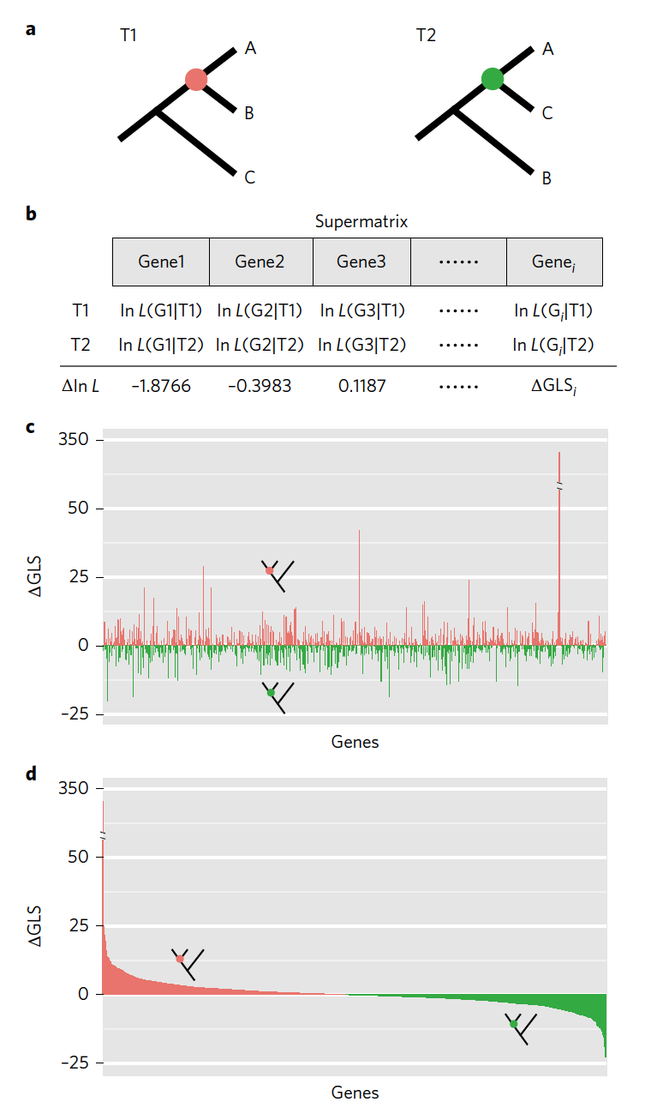
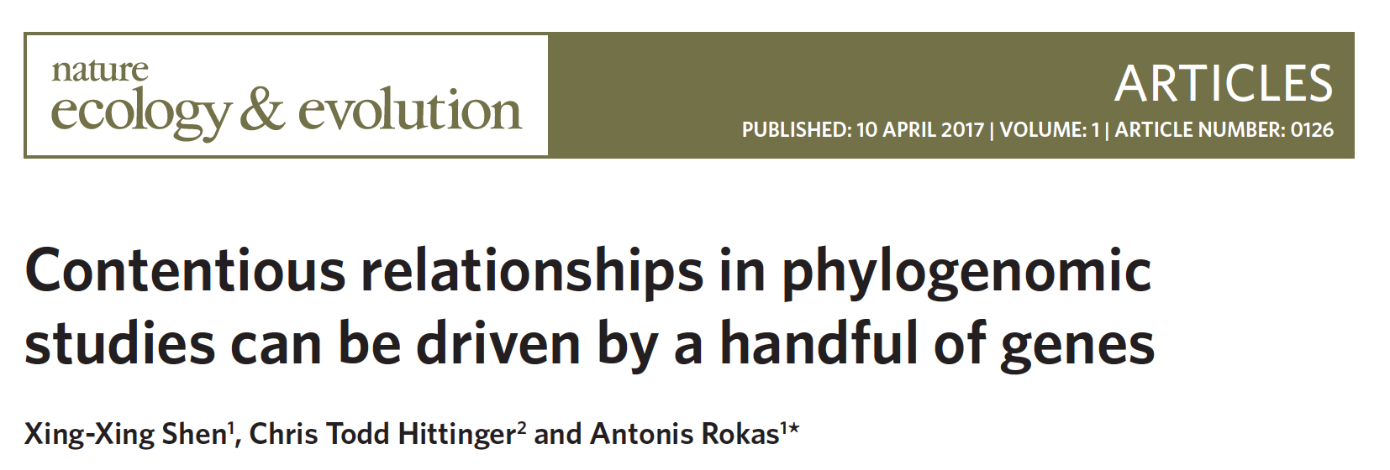
Phylogenetic signal
How is phylogenetic signal distributed in your dataset?
Are there a few genes that have an oversized influence?
Shen et al. 2017

Slide 71
Recommended reading
Yang & Rannala. 2012. Molecular phylogenetics: principles and practice. Nature Reviews Genetics 13, 303-314. doi:10.1038/nrg3186
Nascimento, dos Reis & Yang. 2017. A biologist’s guide to Bayesian phylogenetic analysis. Nature Ecology & Evolution 1, 1446–1454. doi:10.1038/s41559-017-0280-x
Baum & Smith. 2013. Tree Thinking: An Introduction to Phylogenetic Biology. W.H. Freeman, New York.

